Slide 1
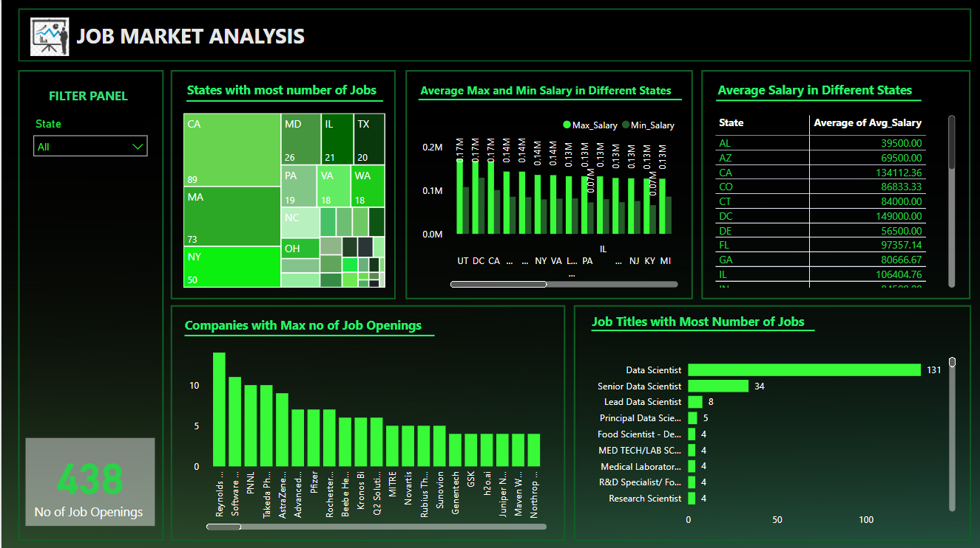
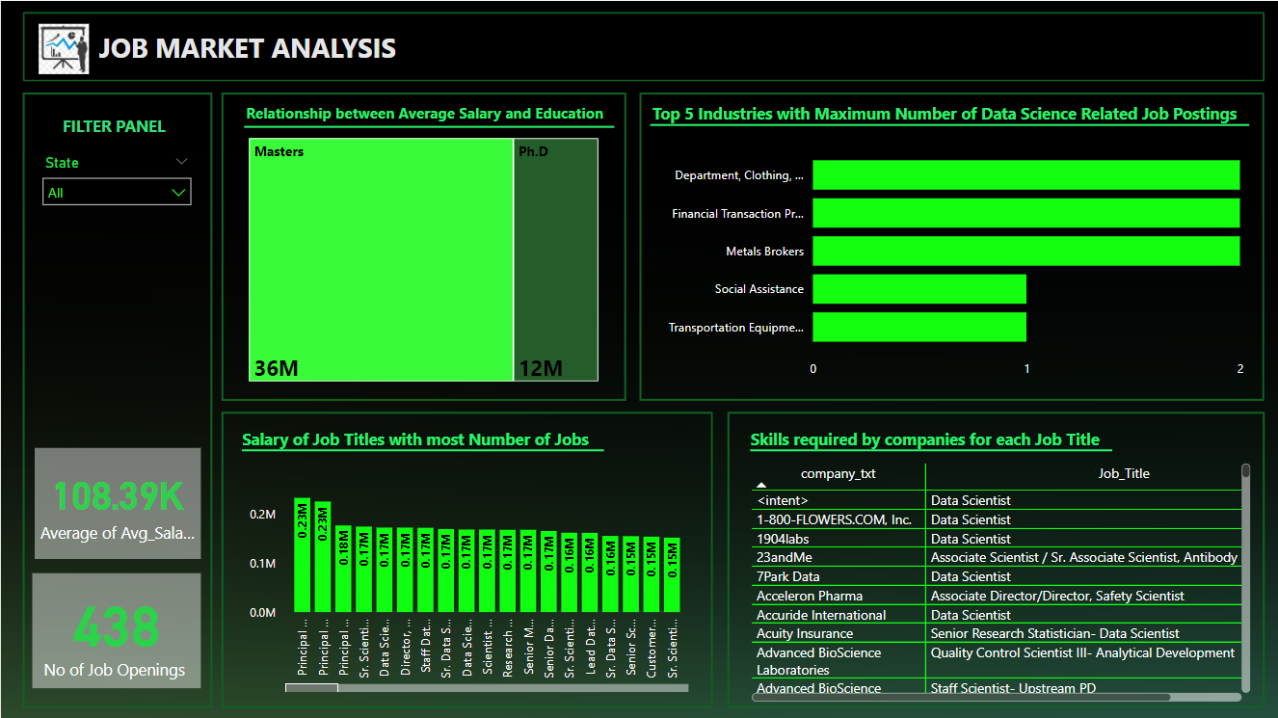
Project Title: Job Market Analysis
First Dashboard
Second Dashboard

Slide 2
